Slide 1
Competitive Landscape
Analytics Consulting Project
July 2023
Sérgio Florido
Carlos Silva
Mariana Sousa

Slide 2
Report
How is Ironhack doing compared to other schools?
Strengthens?
Weaknesses?
Possible improvements?

Slide 3
Method
Databases to collect data from the 5 schools in analyses;
Data cleaning with python:
Select specific columns;
Change columns names;
Data analyses in SQL.

Slide 4
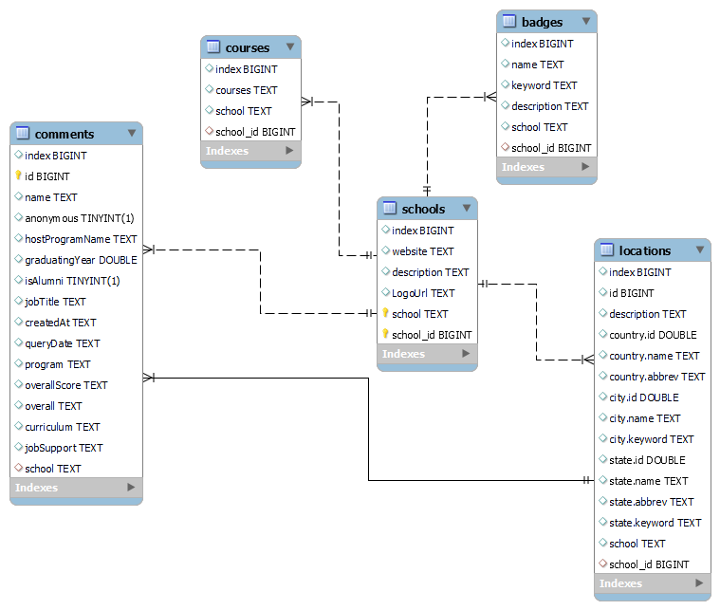
Database Relationship Diagram

Slide 5
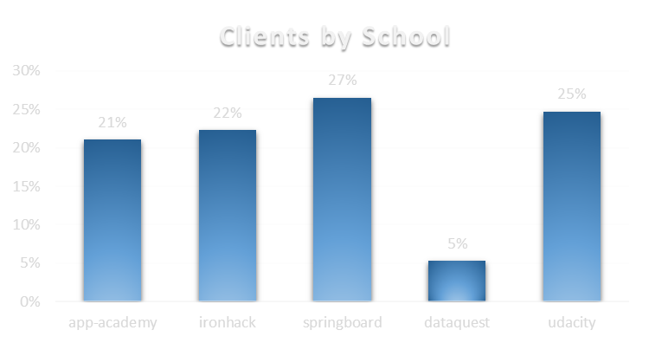
Population
Of all clients over 20% chose IronHack;

Slide 6
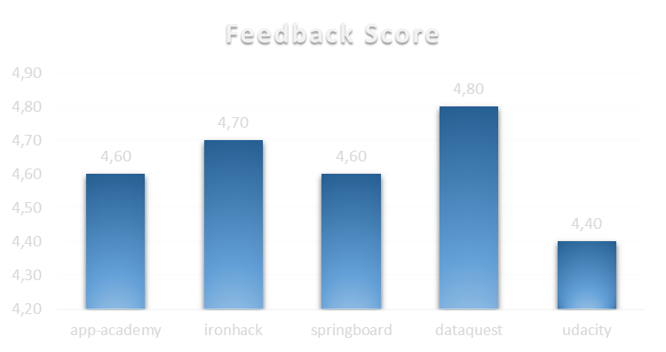
General View
Well classified by the public;
Ironhack has positive feedback;
2nd best.

Slide 7
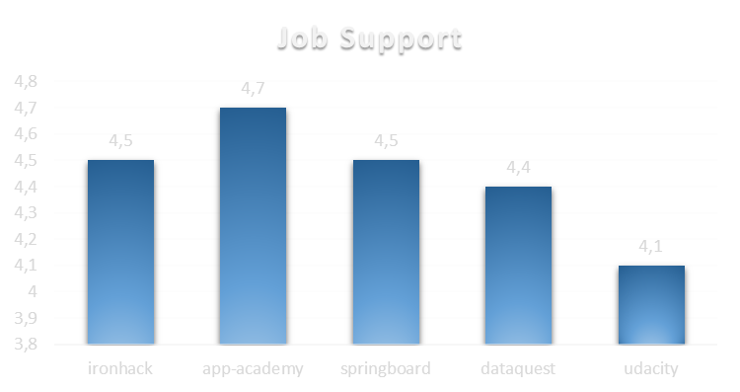
How is the Job Support Service?
IronHack has the best classification amongst schools.

Slide 8
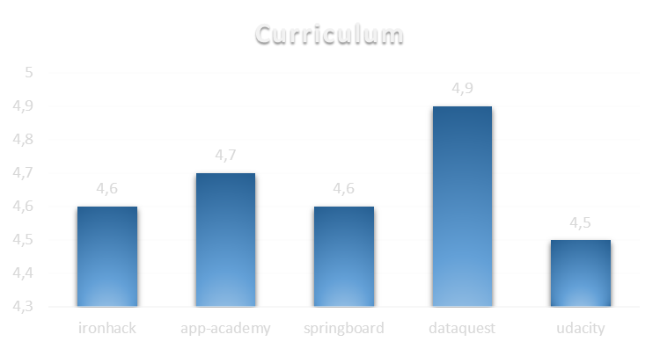
What about the Curriculum?
There is room for improvement.

Slide 9
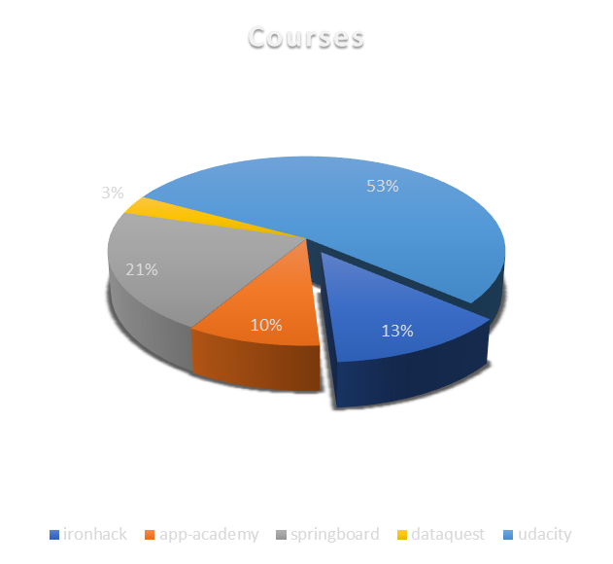
IronHack’s Courses vs other schools
IronHack offers less variety of courses when compared to other schools.

Slide 10
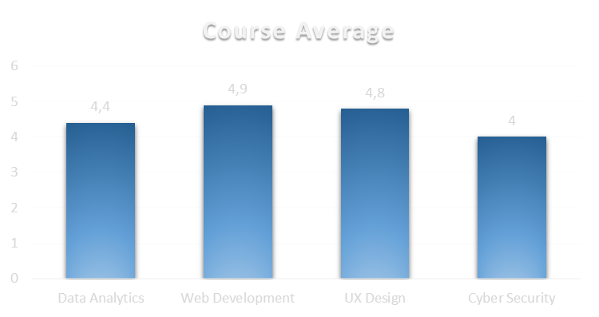
IronHack Course’s Satisfaction
The happier IronHackers are from WebDev;
The Cyber Security program needs improvement.

Slide 11
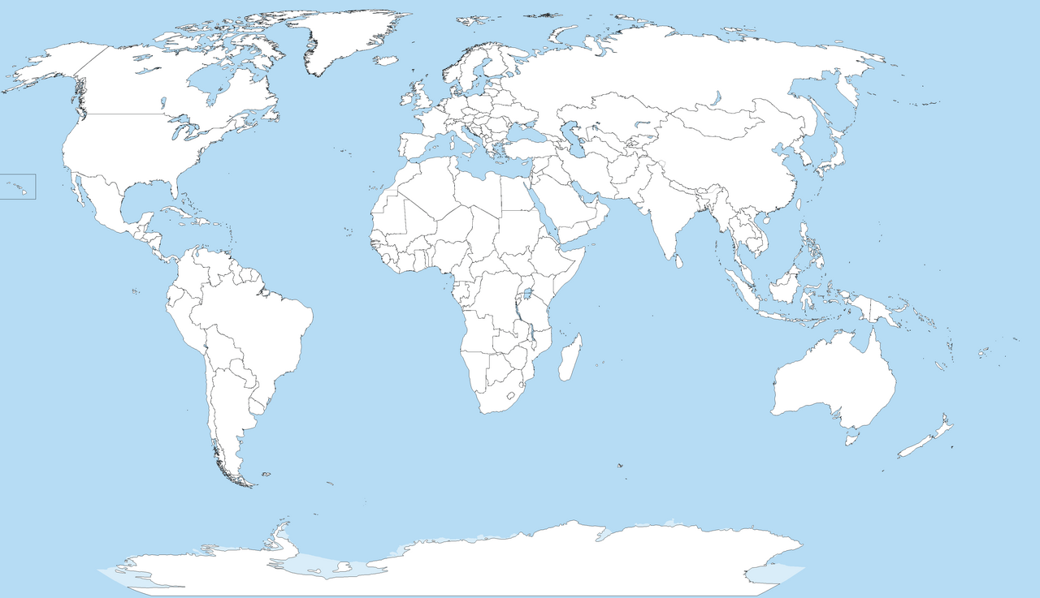

Locations
The IronHack offer is focused on certain continents;
Could expand to new locations.

Slide 12
Report
How is Ironhack doing compared to other schools?
Second Best rated school
Strengthens?
Job Support Service
Weaknesses?
Curriculum
Few courses
Possible improvements?
Expand to new continents

Slide 13
Limitations
Small amount of data from the databases we imported;
Database with a lot of useless data.

Slide 14
Difficulties
Clean the data:
Remove columns to be able to import;
Repeat the importation to change column’s names (.);
Find Primary Keys.

Slide 15
Thank you!!
Data Analytics
Full-time
July 2023
Carlos Silva
Mariana Sousa
Sérgio Flórido

